Slide 2
Vision for Robotic
Applications

Slide 3
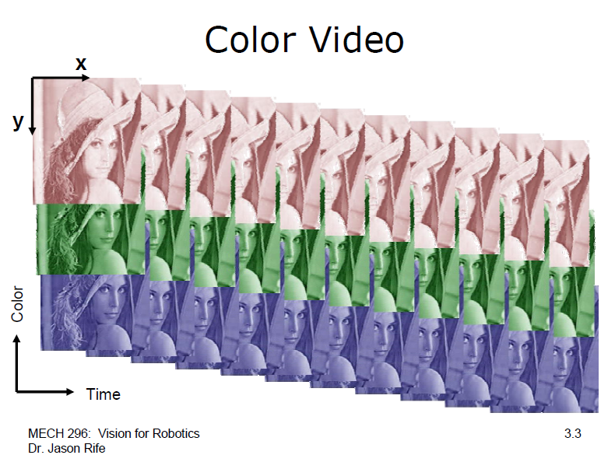

Slide 4
Video Acquisition
− Goal: Visual sensing requires manipulation of video with a digital computer
− Video Acquisition
  • Depends on camera output type
  • Analog Video – framegrabber card required
  • Ex: Plug NTSC signal into Matrox Meteor II board
  • Framegrabber digitizes analog signal and outputs the digital frame into a memory buffer
  • Digital Video – direct interface
  • Video hardware attached to computer via digital input port
  • Digital frames loaded directly into memory (USB, Firewire) or through dedicated framegrabber (Camera Link)
  • OR Digital frames loaded from a video file on hard disk

Slide 5
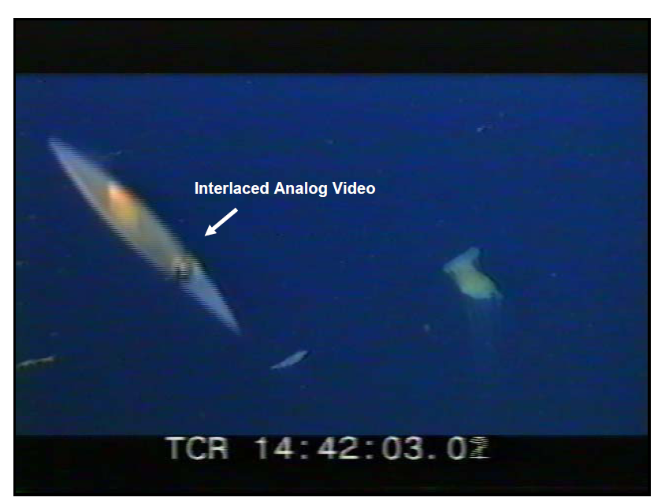

Slide 6
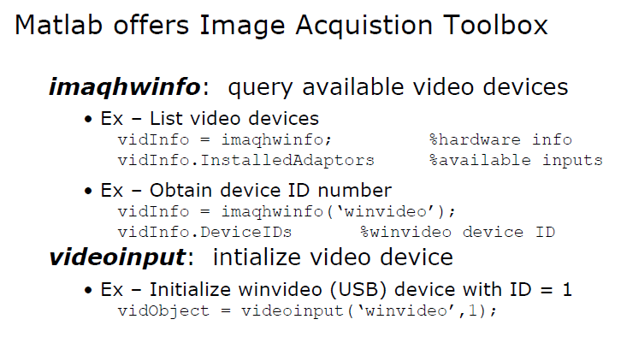
Video Acquisition in Matlab

Slide 7
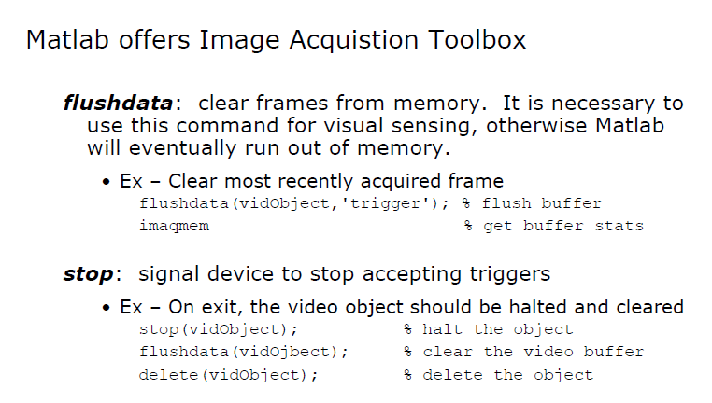

Slide 8
